Slide 1
Glassdoor Reviews Analysis – Competitor Data
By:
Surendra Dattatrey
People Analytics
December 3, 2019

Slide 2
Agenda
Executive Summary
Rating comparison
Analysis of S&P reviews
Comparative analysis of competitors
Comparison of top positive key attributes
Comparison of top negative key attributes
Appendix

Slide 3
Executive Summary
Comparative analysis on text data of S&P.
We included data of competitors like – Bloomberg, CME, ICE, Moody’s, MSCI and Thomson Reuters.
Comparative analysis of top positive and negative keywords.
Review count given in below table –
 | Review count
Bloomberg | 5,200
CME | 540
ICE | 332
Moody's | 789
MSCI | 620
S&P Global | 2,840
Thomson Reuters | 7,581
Rosa: This slide is your 30 second elevator pitch.
What do you want Dimitra to know? What are the findings from your analysis.

Slide 4
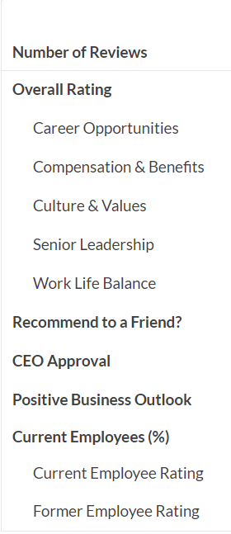
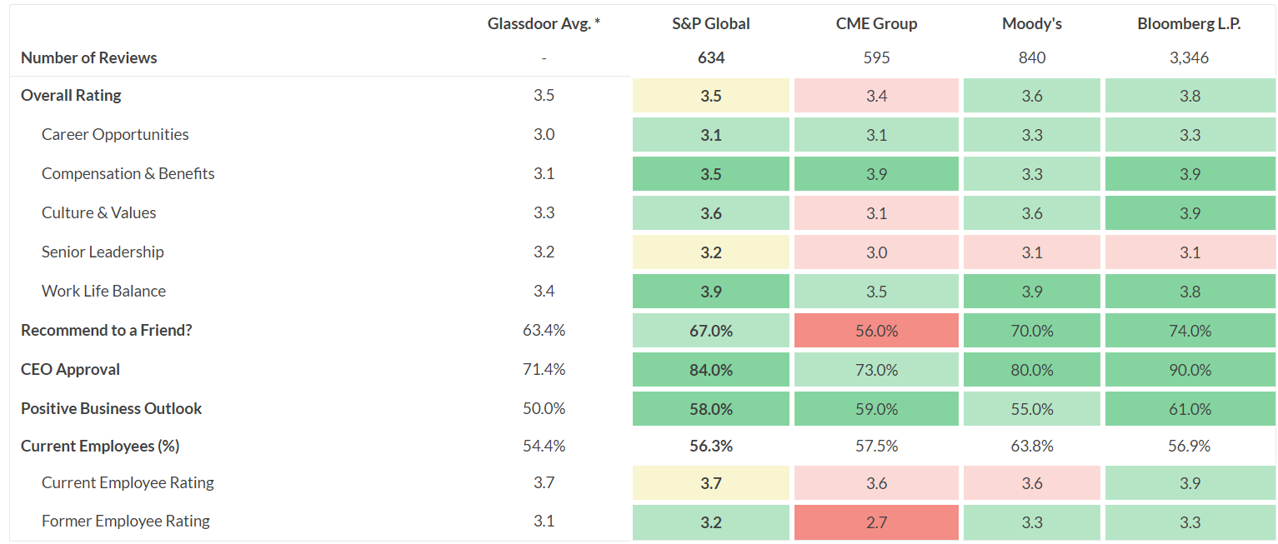
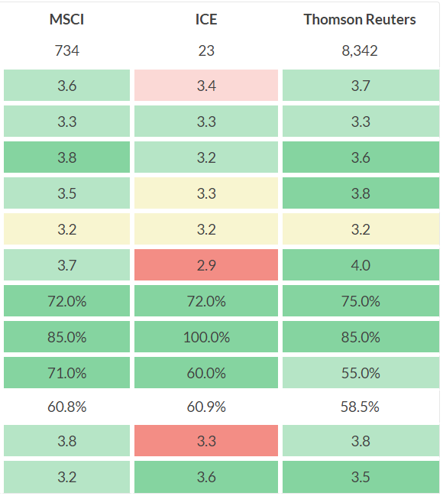
Rating comparison – Glassdoor
* This data is taken from Glassdoor comparison page. This is an average data, was last updated in January 2019.

Slide 5
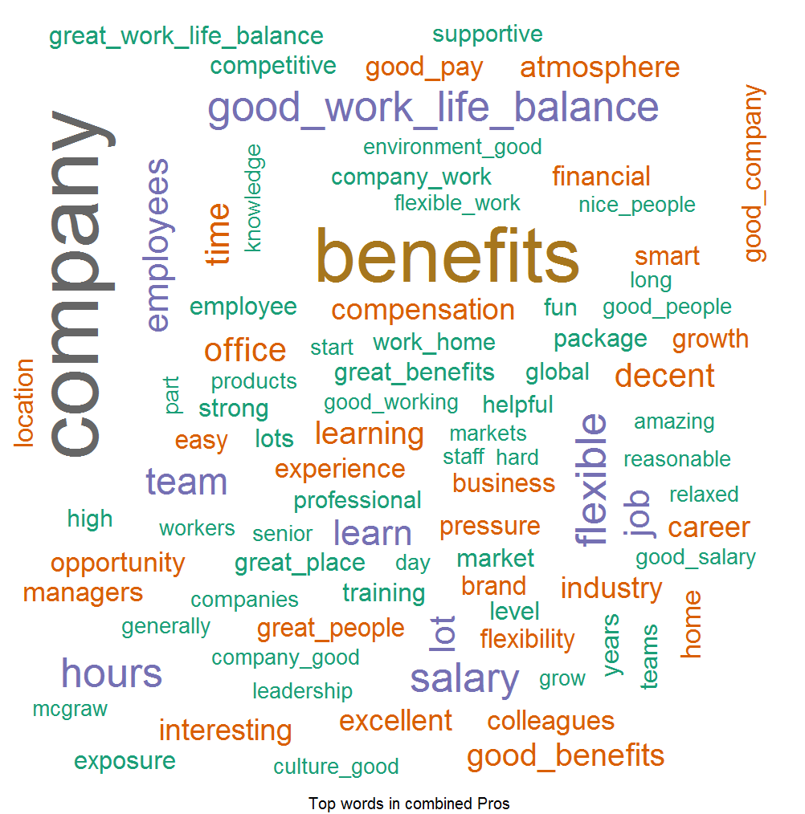
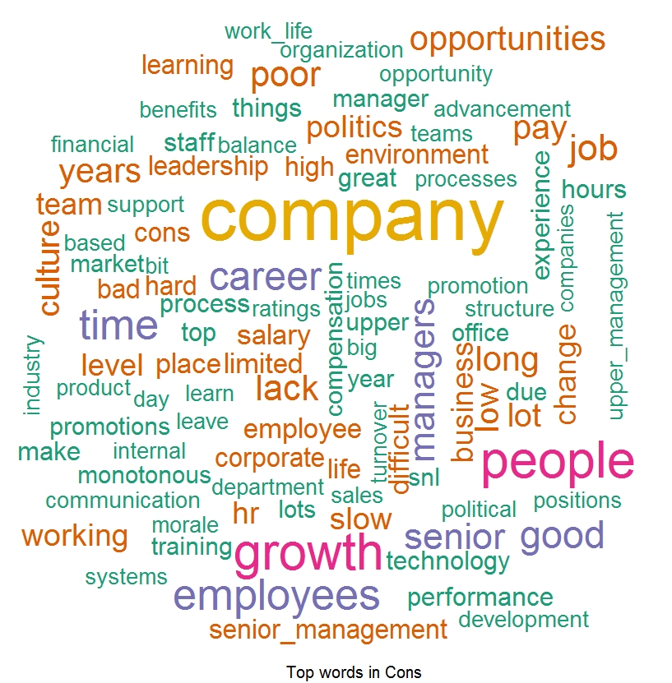
What employees saying about S&P
Pros: Things which Employees liked –
According to Employees feedback, we found out that people love our Good Benefits, Good Work Life Balance, Good Company, Good People, and Opportunities provided by S&P and they are spreading good words on this front.
Cons: Word List which Employees don’t like –
Feedback provided by the Employees they found out to difficulty to cope up with Opportunities, Work Life, senior management, HR Processes, Monotonous Work, Growth, Promotions, and Layoffs and this can be improved.

Slide 6
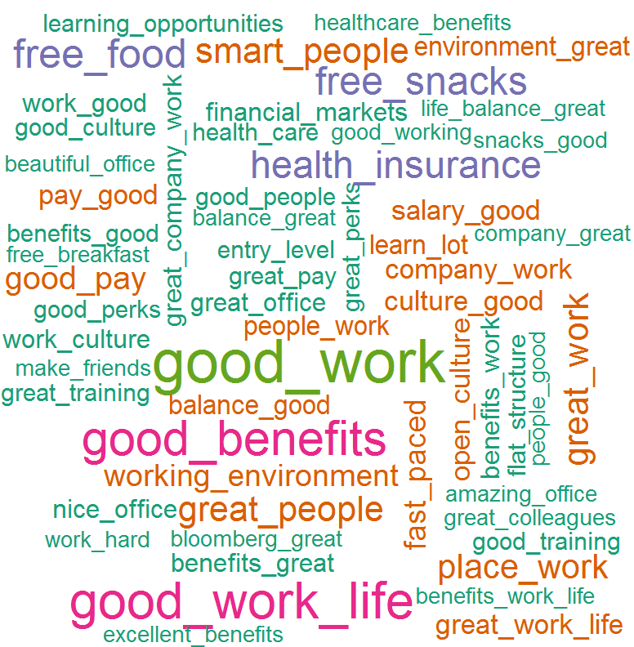
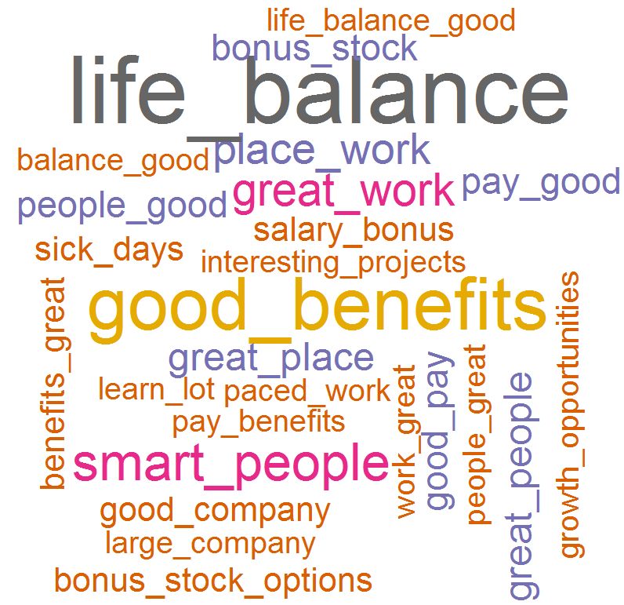
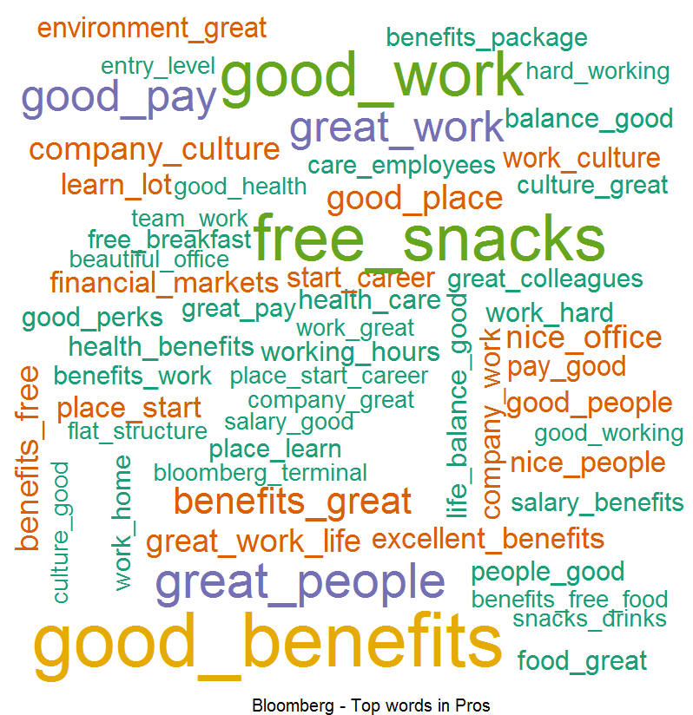
Comparative analysis with competitors
Rosa: Is there a common theme among competitors? For example, work life balance seems to come up a lot. Is there a story around there?
Bloomberg Pros:
CME Pros:
ICE* Pros:
Top Keywords –
Free Food
Great Benefits
Work life balance
Free snacks
Good Work
Top Keywords –
Work life balance
Great benefits
Good work
Great company
Free food
Top Keywords –
Work life balance
Good benefits
Good work
Fast paced environment
Smart people
Work environment
Smart people
Work environment
Great place
Fast paced environment
Good pay
Great culture
Free snacks
Health insurance
Good salary
Great people
Good pay
Stock options
Good people
Good compensation
Cutting edge technology
Great place
Good pay
*Intercontinental Exchange

Slide 7
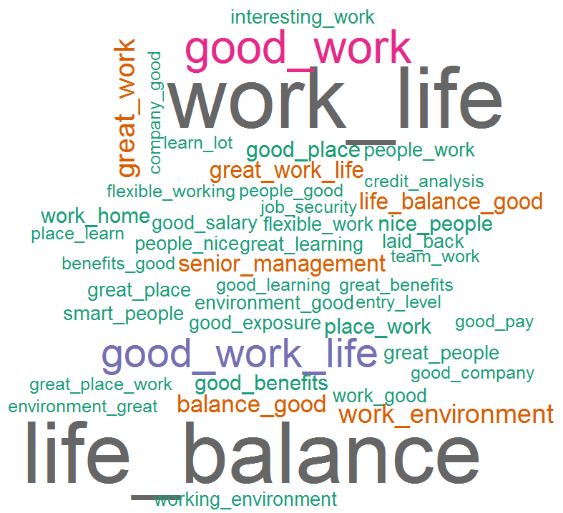
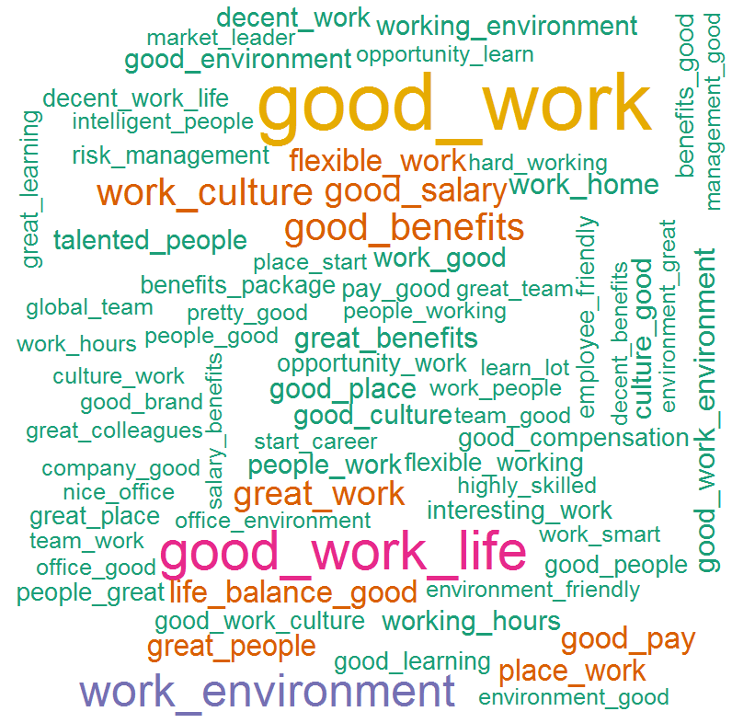
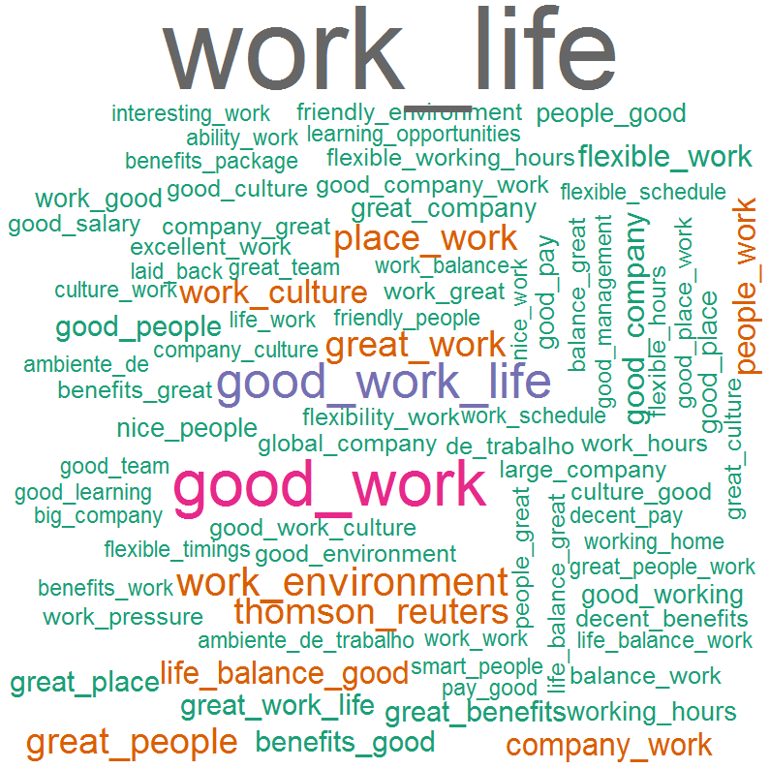
Comparative analysis with competitors
Rosa: Same feedback as previous slide
Moody’s Pros:
MSCI Pros:
Thomson Reuters Pros:
Top Keywords –
Work life balance
Good Work
Work environment
Senior management
Good place
Good benefits
Nice people
Work from home
Smart people
Interesting / flexible work
Good salary
Top Keywords –
Work life balance
Work environment
Good benefits
Work culture
Smart people
Great work
Good salary
Flexible work
Work from home
Working hours
Good culture
Talented people
Top Keywords –
Work life balance
Good work
Good benefits
Work environment
Great people
Work from home
Work culture
Flexible working
Employee friendly
Flexible hours
Work pressure
Friendly environment

Slide 8
Comparison of top positive key attributes (Word proportions out of 1)
Key attributes | S&P | Bloomberg | CME | ICE | Moody’s | MSCI | Thomson Reuters
Benefits | 0.08 | 0.12 | 0.13 | 0.08 | 0.05 | 0.07 | 0.07
Work life balance | 0.13 | 0.43 | 0.07 | 0.04 | 0.13 | 0.10 | 0.11
Free food / snacks | 0.003 | 0.4 | 0.04 | 0.01 | 0.00 | 0.0 | 0.003
Work | 0.31 | 0.24 | 0.20 | 0.20 | 0.26 | 0.33 | 0.32
People | 0.10 | 0.12 | 0.08 | 0.14 | 0.11 | 0.17 | 0.11
Work environment | 0.08 | 0.34 | 0.07 | 0.06 | 0.10 | 0.05 | 0.07
Health Insurance | 0.003 | 0.03 | 0.04 | 0.01 | 0.03 | 0.008 | 0.005
Salary / pay | 0.07 | 0.07 | 0.06 | 0.02 | 0.07 | 0.08 | 0.05
Employee friendly | 0.04 | 0.02 | 0.02 | 0.03 | 0.05 | 0.03 | 0.04
Great place to work | 0.06 | 0.07 | 0.02 | 0.06 | 0.04 | 0.06 | 0.07
Fast paced environment | 0.003 | 0.02 | 0.03 | 0.03 | 0.005 | 0.0 | 0.0
Cutting edge technology | 0.00 | 0.002 | 0.001 | 0.03 | 0.0 | 0.006 | 0.0
Culture | 0.06 | 0.001 | 0.08 | 0.02 | 0.05 | 0.08 | 0.06
Work from home | 0.02 | 0.001 | 0.003 | 0.003 | 0.03 | 0.02 | 0.04
Flexibility | 0.04 | 0.01 | 0.01 | 0.01 | 0.03 | 0.03 | 0.05
Working hours | 0.04 | 0.02 | 0.005 | 0.01 | 0.03 | 0.02 | 0.03
Senior Management | 0.04 | 0.02 | 0.01 | 0.04 | 0.06 | 0.06 | 0.03
Rosa:
Could we change this to a heat map?
Change to 2 decimals
What is “word proportions out of 1”?
Could we change title to something more insightful?

Slide 9
Negative key attributes (Word proportions)
Key attributes | S&P | Bloomberg | CME | ICE | Moody’s | MSCI | Thomson Reuters
Working hours
Work life balance
Management
Career advancement
Red tape
Politics
Career growth
Work from home
Salary / Pay
Culture
High turnover
Cost cutting
Decision making

Slide 10
Appendix

Slide 11
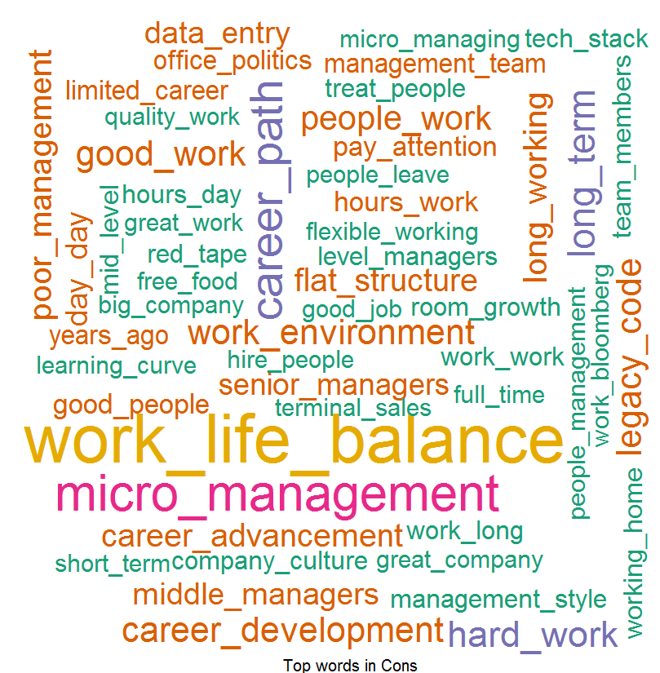
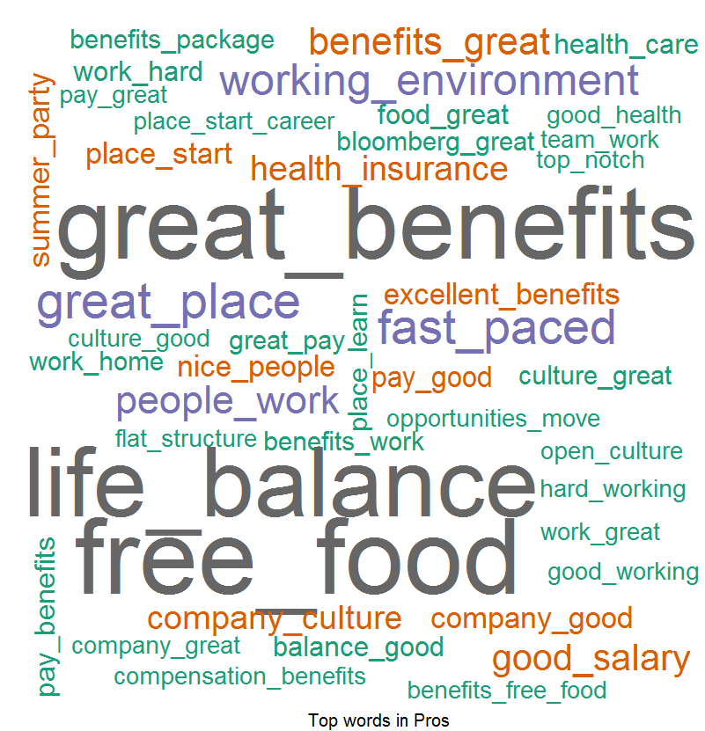
Overall Word Cloud For Pros and Cons – For Bloomberg
Word Cloud for Pros
Word Cloud for Cons
Good Words List –
Free food
Great Benefits
Work Life Balance
Free snacks
Good Work
Smart people
Word List which people don’t like –
Long hours
Work life balance
Middle management
Team leaders
Working hours
Micro Management
Career Progression

Slide 12
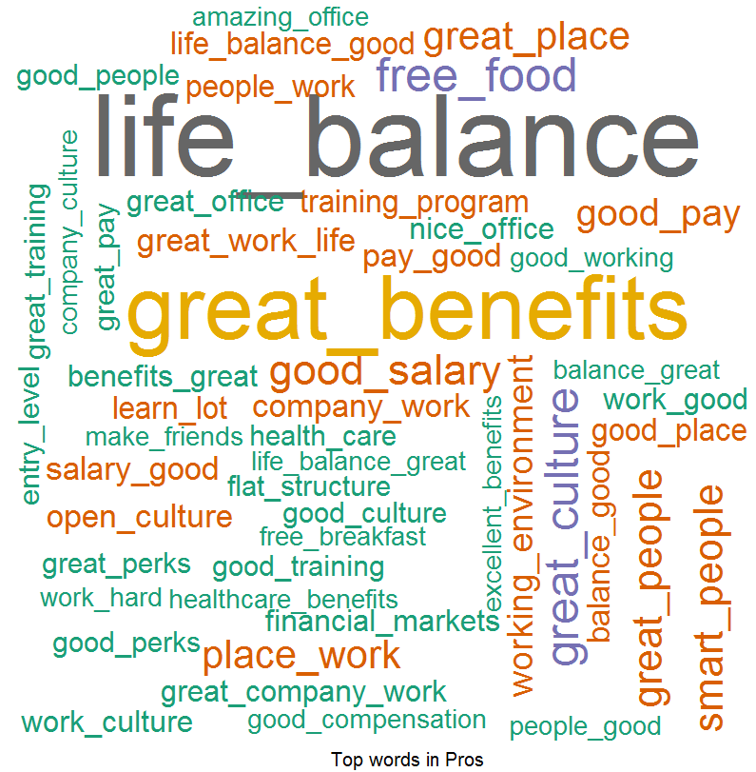
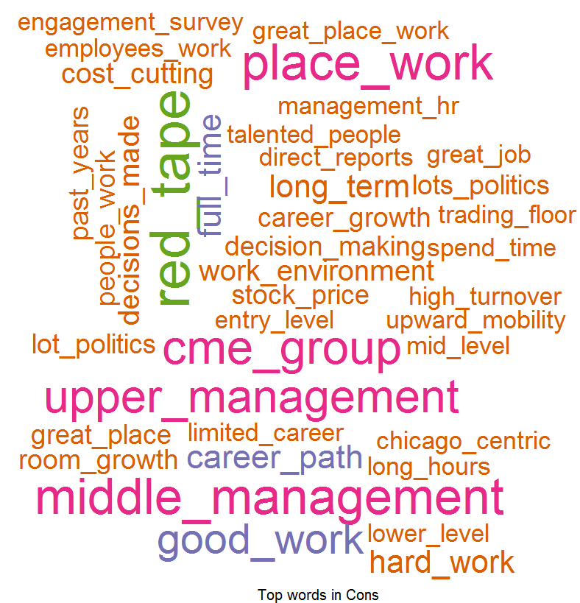
Overall Word Cloud for Pros and Cons – FOR CME
Word Cloud for Pros
Word Cloud for Cons
Good Words List –
Work life balance
Great Benefits
Good work
Free food
Great Culture
Health insurance
Word List which people don’t like –
Senior management
Work life balance
Red tape
Middle management
Upper management
Career path
Career advancement
Lots of politics

Slide 13
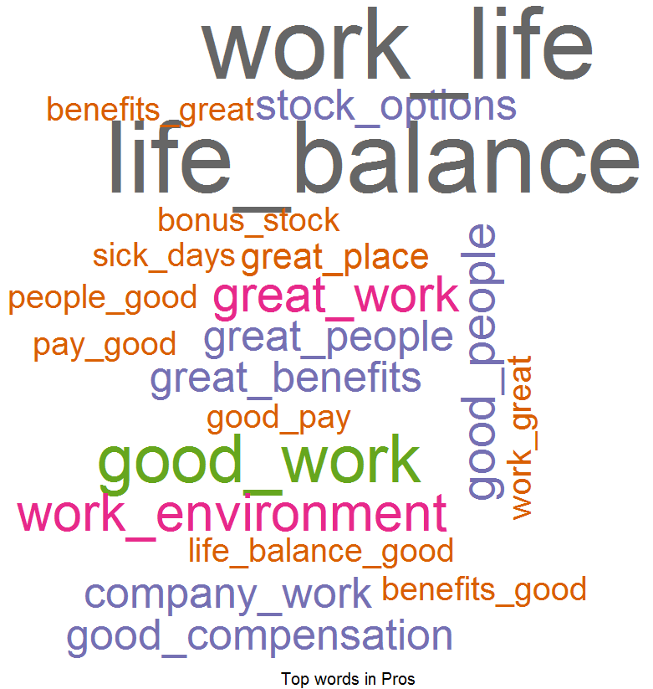
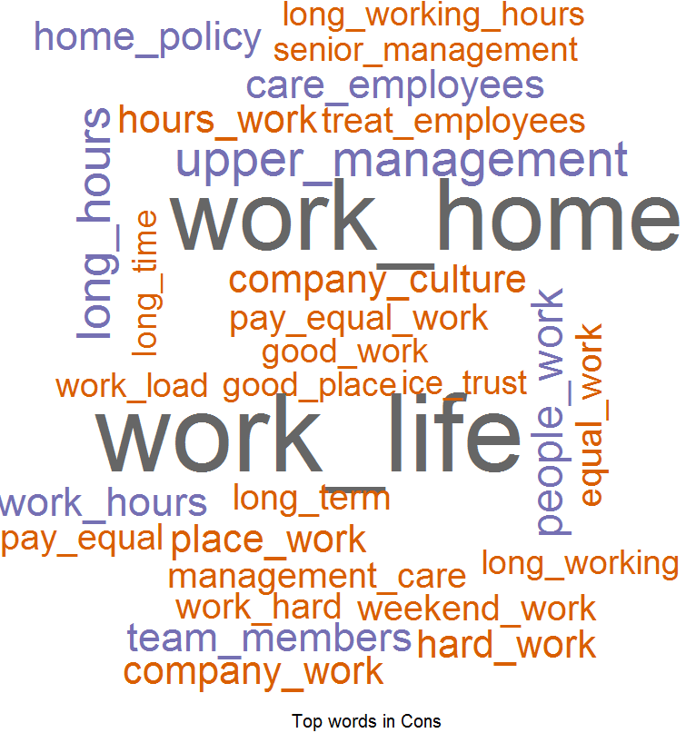
Overall Word Cloud for Pros and Cons - ICE
Word Cloud for Pros
Word Cloud for Cons
Good Words List –
Work life balance
Good benefits
Good work
Fast passed work environment
Good people
Stock options
Word List which people don’t like –
Work life balance
Work from home policy
Upper management
Long hours
Working hours
Career growth
Care for employees
Hard work

Slide 14
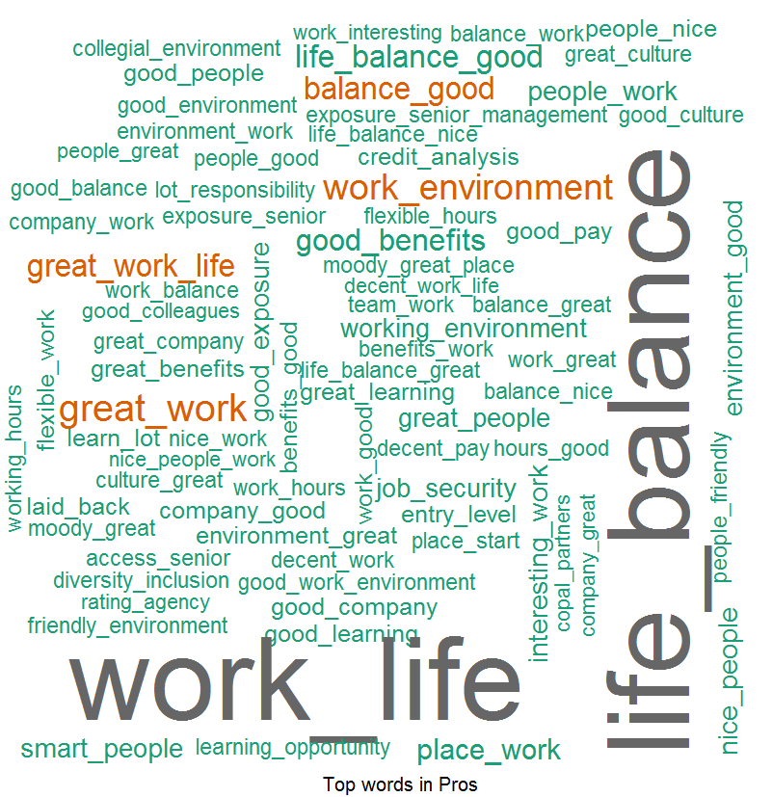
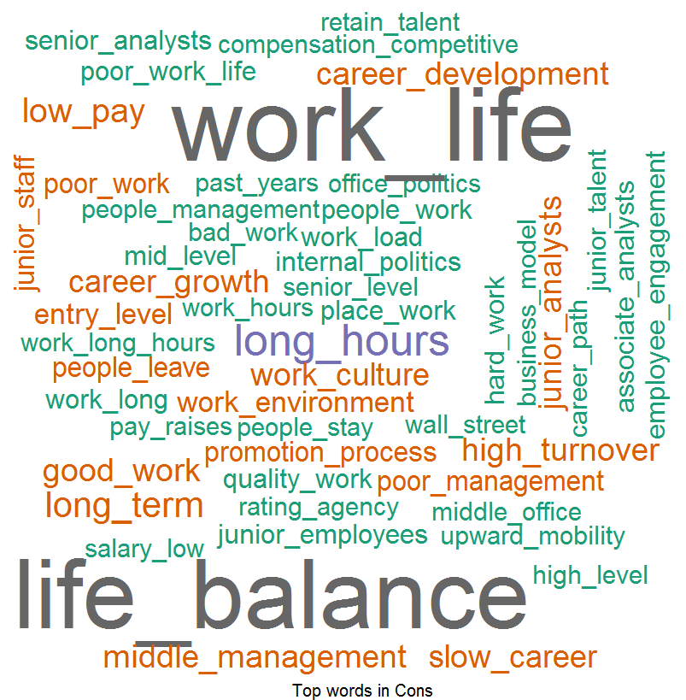
Overall Word Cloud for Pros and Cons – Moody’s
Word Cloud for Pros
Word Cloud for Cons
Good Words List –
Work life balance
Good work
Work environment
Senior management
Good place to work
Good benefits
Word List which people don’t like –
Work life balance
Senior management
Long working hours
Career progression
Low pay
Middle management
High turnover
Work culture

Slide 15
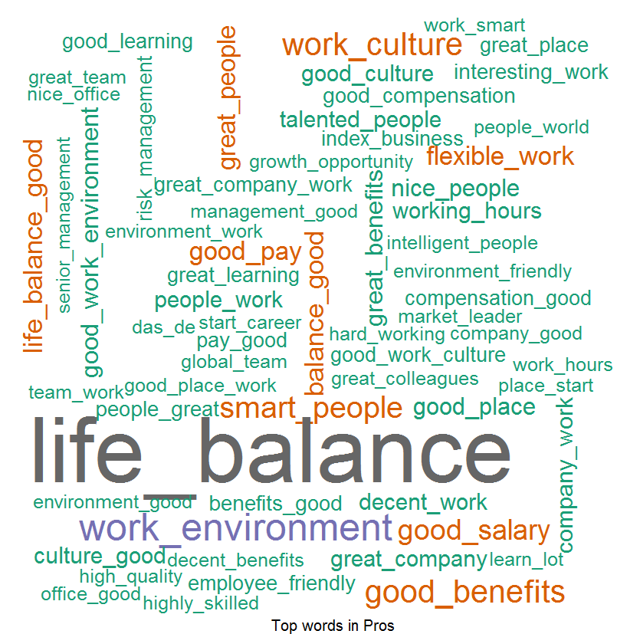
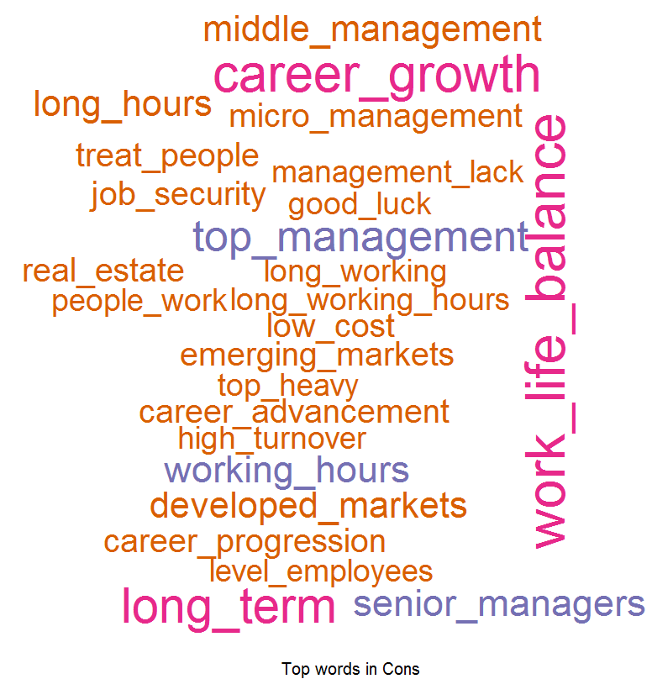
Overall Word Cloud for Pros and Cons – MSCI
Word Cloud for Pros
Word Cloud for Cons
Good Words List –
Work life balance
Good work
Work environment
Good benefits
Work culture
Smart people
Word List which people don’t like –
Senior management
Cost Cutting
Career development
Work life balance
Career growth
High turnover
Work culture

Slide 16
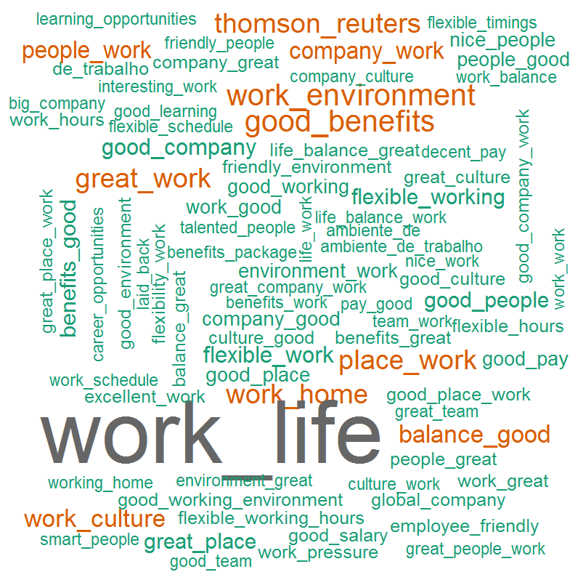
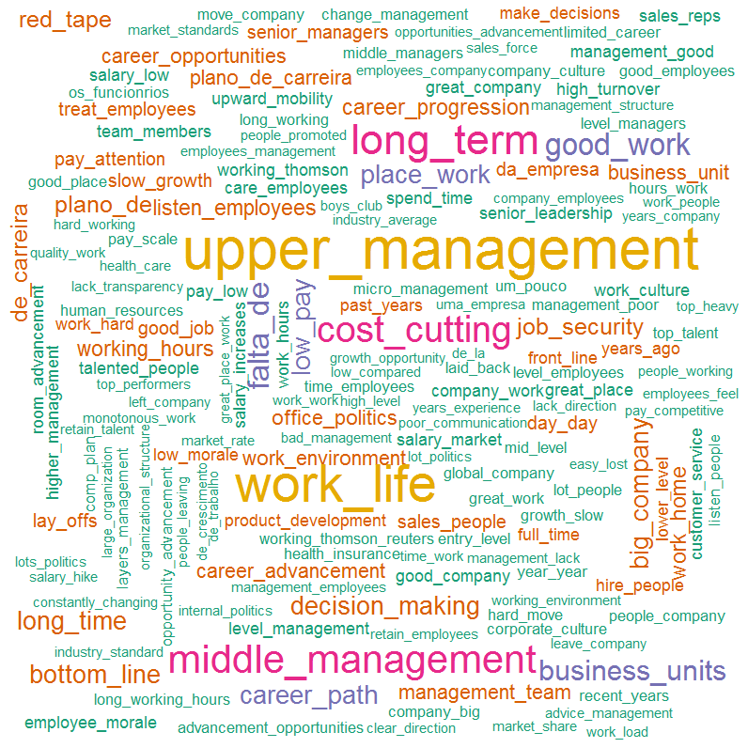
Overall Word Cloud for Pros and Cons – Thomson Reuters
Word Cloud for Pros
Word Cloud for Cons
Good Words List –
Work life balance
Good work
Good benefits
Work environment
Great people
Work from home
Word List which people don’t like –
Senior / upper management
Work life balance
Career growth
Work life balance
Cost cutting
Career path
Low pay
Decision making

